Slide 1

Traffic Volume Prediction
Mayuri walke
Shruti walunj
Dinesh salunkhe

Slide 2
Objective:
Development of a predictive regressor model to find traffic volume in specific day time. This model requires weekday, month, whether that day is holiday time or not, the time of day like morning, afternoon, weather condition, numeric percentage of cloud cover and temperature of weather on that time respectively.
Benefits:
This model can be used to determine the traffic volume instantly and can be used to help government organizations, agencies.

Slide 3
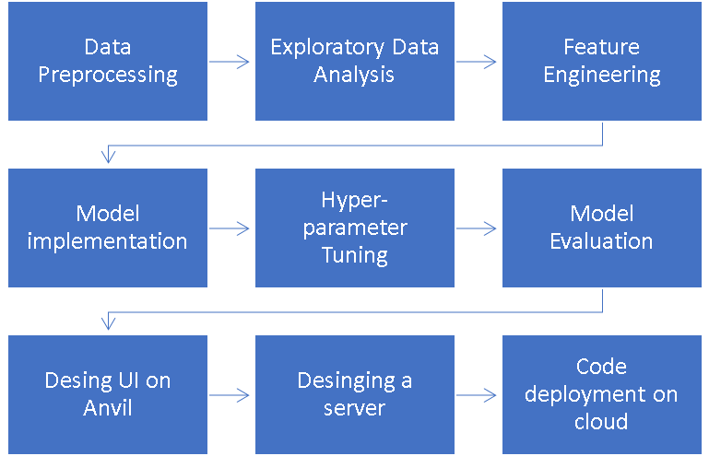
Architecture
Data Preparation
Model development
Deployment

Slide 4
Data validation and transformation
dAta type | Null values | Numerical columns | Categorical columns
Data type of columns is given in the schema file. It is validated when we insert the files into Database. | If any of the columns in a file have all the values as NULL or missing, we can fill it by some methods. | All the numerical features were standardized using Standard Scaler, preventing any data leakage. | Ordinal Encoding was used to treat categorical columns for the model in understandable way.
If data type is wrong, we can convert it using pandas library. | We can fill them by using mode of categorical columns or mean of numerical columns. | This process is done in pipeline for numerical features for the convenience of deployment. | This process is done in pipeline for categorical features for the convenience of deployment.

Slide 5
Data Insertion in Database.
Cassandra Database - The dataset was imported to Cassandra database from where we can access it with the help of python
Insertion of files in the table - All the data is uploaded into a table named “traffic_volume” into which is present inside a database named “metro_traffic”.

Slide 6
Model Training
1. The data in database is imported to Jupyter notebook by using pandas.
2. In data preprocessing step, data is checked if there missing data, duplicate values, and datatypes of each feature. In our dataset, there was not any null and duplicate values.
3. After bivariate and univariate analysis of features, outliers were checked using boxplots, and outlier treatment was carried out as well. Distribution of numerical values is plotted to see to what extent our data is skewed .
4. After train and test splitting, pipeline containing Standard Scaler and Ordinal Encoder was fitted to several models.

Slide 7
Model Selection:
Having trained several models and obtained R2 scores, it was determined that CatBoost performs better than other models. GridSearch and CrossValidation is used then to optimize our model.
Prediction
The model is made in such a way to maximize the accuracy and also other performance metrics so that the predictions are as accurate as possible
The average accuracy after cross validation

Slide 8
Q&A
What is the sourse of data? | What was the type of data? | What is the complete flow you followed in this project? | How are logs managed?
The data for training is provided by the client in the form answers to certain questions asked . User has to enter answers for those questions. | The data is the combination of both numerical and categorical values. | Refer to 3rd slide for the process flow. | Following s are the logs that we are using : Data Insertion log, Model Fitting log, prediction log, etc.

Slide 9
What techniques were you using for data pre-processing?
Removing unwanted attributes
Visualizing relation of independent variables with each other and output variables
Checking and changing Distribution of continuous values
Removing outliers
Cleaning data and imputing if null values are present.
Converting categorical data into numeric values.
Scaling the data

Slide 10
How training was done or what models were used?
First, we started with data cleaning, EDA and feature engineering. Data type of columns were corrected by using pandas attributes.
Then, outliers and ambiguities were removed from the data. Categorical features were encoded by applying One-hot encoding, and numerical columns was scaled using Standard Scaler.
Data pipeline was created to implement data scaling, one-hot encoding and an estimator to prevent any data leakage.
CatBoost model was used as the best estimator which was then used for production followed by hyperparameter tuning.

Slide 11
How was prediction done?
Some questions were asked to the user like date, time of day, weather condition, numeric percentage of cloud cover, and the temperature of weather and these responses are taken as inputs which are then feed to the model as a single test case and the traffic volume prediction are then returned on the screen after a few seconds in which the data pipeline processes the input data to get the output.
What are the different stages of deployment?
When the pipeline is ready, we connected the front-end made on Anvil with the backend code having the pipeline on the local machine via anvil uplink.
A server is created in Flask which just displays a single web page and runs the uplink code via threading thereby creating a server.
The Flask page was then deployed to heroku cloud.
A cron job was set on the heroku platform to load the flask app every 30 minutes to keep the uplink connected and running the uplink code forever.

